Slide 1











COVID-19 & Ethnicity

Slide 2






Team Members

Slide 3
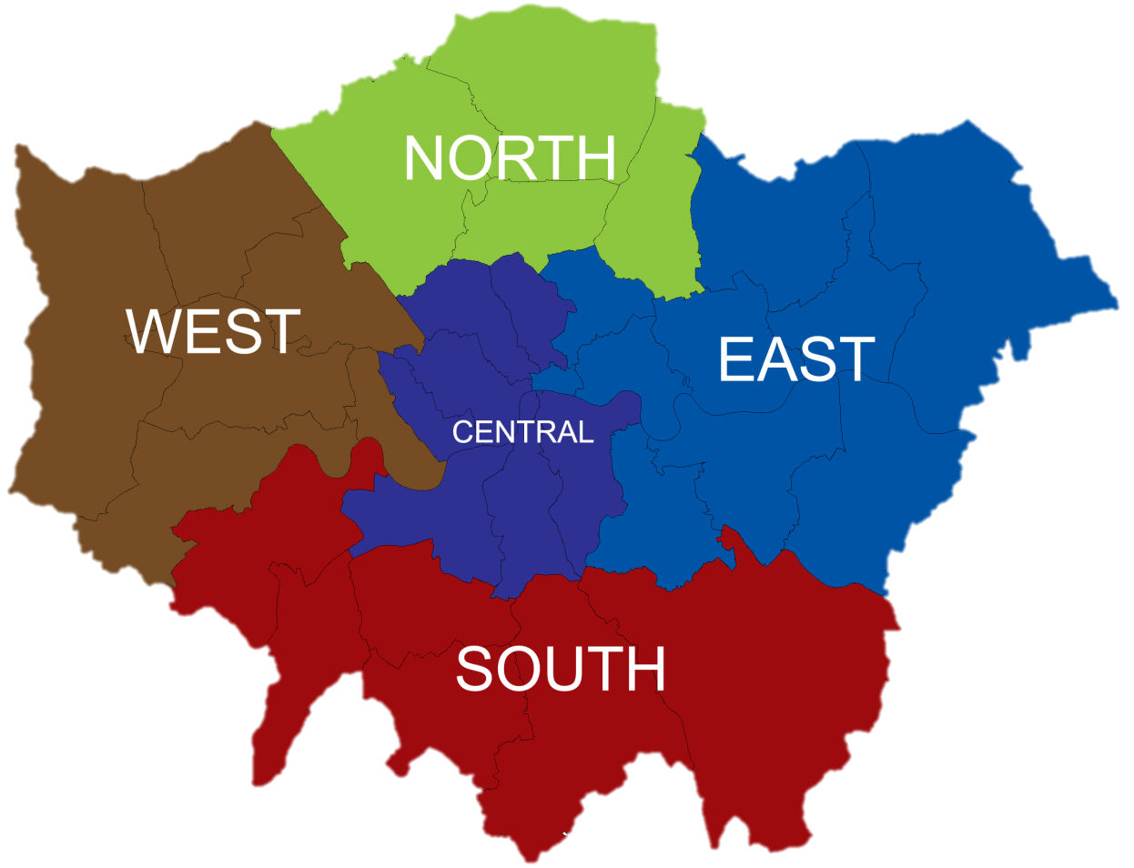
Which ethnic group was more susceptible to COVID-19 in London?
[by sub-region] March 2020 – March 2021

Slide 4

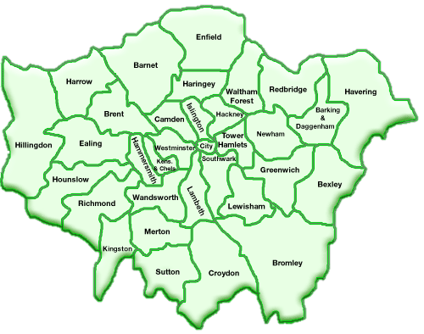
London is made of 5 sub-regions, consisting of 32 Boroughs

Slide 5
Project Objectives
Main Questions
COVID-19 - Which race is more susceptible to coronavirus in the London boroughs?
What is the population structure for each region of London? (From 32 London Borough data)
Are cases/deaths different between different ethnic groups in London?
Is the difference in ethnic minority demographics between London regions related to differences in Covid-19 number of deaths/cases/deaths within 28 days positive test?
Has this changed over time?
Is vaccine uptake different between ethnic groups in London?
Opportunity for forecasting/machine learning in this area potentially?

